Slide 1
Design pattern: Observer
Notes:
Objectives:
Understand the observer design pattern.
Understand the push and pull variants of the pattern.
Relate to the dependency inversion principle.
Understand C# delegates and events.

Slide 2
The general “data-update” problem
Provider contains data which changes every now and them
Consumer uses data and would like to do some update based on changes in data
How can we realize this coupling?

Slide 3
Discuss pros and cons of these typical solutions:
Provider notifies Consumer when data changes
Consumer polls Provider
Events – I know
Notes:
There is very high coupling between producer and consumer.

Slide 4
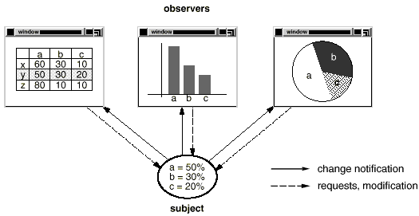
Simple example
Notes:
Typically, the provider holds data, which is interesting for multiple consumers.
TODO: Find a better looking example.

Slide 5

GoF Observer
We need some mechanism that…
allows Consumers to be added to the Provider without changing the Provider (i.e. adhere to OCP)
allows Provider to inform Consumers of data changes (i.e. promotes low coupling)
allows many Consumers to be informed on updates of same data
We need….GoF Observer!
Define a one-to-many dependency between objects so that when one object changes state, all its dependents are notified and updated automatically

Slide 6
Observer class diagram
Subject is an abstract base class for all data subjects
(i.e. things that get updated)
Observer is an interface that must be implemented by all classes that wish to be informed of data changes
ConcreteSubject inherits from Subject. This is the actual class that must be monitored (in our case, Provider)
ConcreteObserver implements the Observer interface. This is the actual class that must receive updates (in our case, Po)
Notes:
What is the responsibility of the abstract Subject class?

Slide 7
Naming
Subject, provider, observable
Just different names for the same thing.
Consumer, observer
Also just different names for the same thing.

Slide 8
Notifications, sequence diagram
Notes:
Note that the concrete observer knows the concrete subject, in order to subscribe to it.
The subject does not know the type of the class subscribing to it, only that they implement the Observer interface.

Slide 9
Example: Blood Pressure Measurement
Description:
A system to measure and display blood pressure
Measurement:
Set systolic BP
Set diastolic BP
Set “measurement complete”
Display:
When measurement is complete: Display systolic and diastolic BPs
Sys: 123
Dia: 60
*Done*
Systolic BP: 123
Diastolic BP: 60
Meassurement
Display

Slide 10
Example: Blood Pressure Measurement
Your task: Design this system using GoF Observer.
Think about:
What is the Subject, what is the Observer
What methods / properties do you need in the Measurement class
What methods / properties do you need in the Display class
Sketch the class and sequence diagrams for you design
Systolic BP: 123
Diastolic BP: 60

Slide 11
Many observers to one observable
Let the subject hold a list of observers.
Then many observers can attach to the same subject.
An observer can remove it self from the list, by calling Detach.
Notes:
TODO: Shall we include the variant, where the same observer can be notified by many different observables?

Slide 12
Push variant

Slide 13
Push vs. pull
Pull variant (Observer pulls state from subject)
Push variant (Subject pushes state to observer)

Slide 14
GoF Observer – handling subjects of different types
How can we handle observers that connect to subjects of different types?
Use C# generics to specify the type of subject(s) to observe
Implement Update for each SubjectType
Covered in 4th semester
Notes:
Får de i SW4SWD

Slide 15
C# Specific: events
On subject (observable)
1) Define data and event
public class BPDataArgs : EventArgs {
public int Systolic { get; set; }
}
public event EventHandler<BPDataArgs> BPEvent;
2) Subscribe (observer)
public void Display(Subject subject) {
subject.BPEvent += HandleNewBPData;
}
A provider can have multiple subjects
The update method can be called anything
Can attach to multiple subjects

Slide 16
C# Specific: events
Provider don’t know observers or their method name
3) Send update to observers (subject)
private void OnNewData() {
BPEvent?.invoke(this, new BPDataArgs() {
Systolic = newSystolic
}
}
4) Handle event (observer)
private void HandleNewBPData(object sender, BPDataArgs e) {
MySystolicCopy = e.Systolic;
// Other work done on new data
}
Observer can identify the provider by looking at the sender parameter.

Slide 17


Slide 18
References
Questions-Answers: https://www.pexels.com/photo/questions-answers-signage-208494/

Slide 19
Notes:
19

